Slide 1
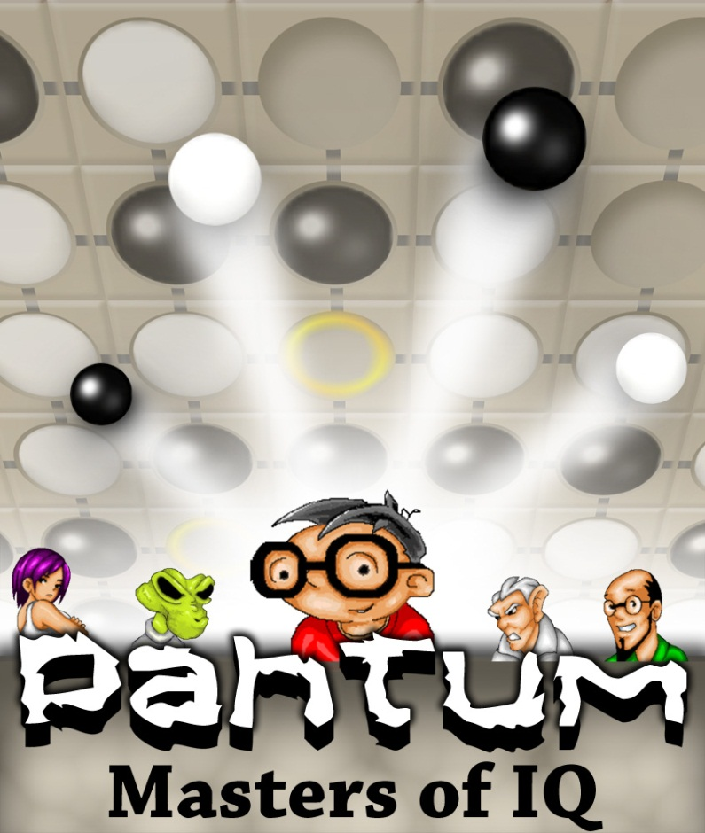
Pahtum comments /mobile game for Android based on J2ME game

Slide 2
Language
Languages have some missing characterers, like in Portugese, Musica is Msica
Rectangle around selected language shoud be more concrete, now is not so visible. It should have more fat line
In main menu, language German exit texti is over the screen(fixed before 22)
When turn is on player, can you just remove work „Than“ from Than you in all languges, leave only „You“ for EN, Sie for German, Vous for FR,

Slide 3
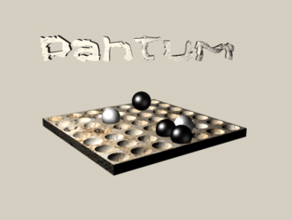
Help & about sceen
About text should be put after current text in help section
Is it possible that text is scrolling slowly?
The image is not at right place, can you put it
After text in help? Now looks strange there, not right place. If not possible to add it after text, remove the image of pahtum.

Slide 4
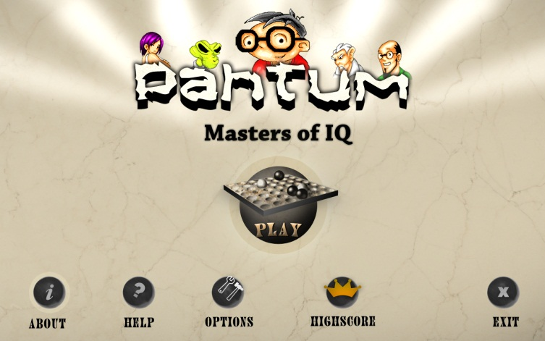
Menus
Many times, it is hard to pres any menu button at the bottom, buttons in middle of screen work all the time, only small menu buttons at the bottom have problems, not work always. Play and other buttons in middle are OK.

Slide 5
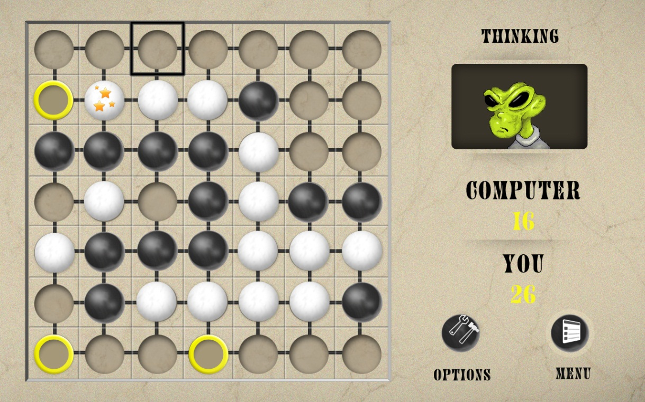
All versions
Stones have pattern, if you put many white stones, you will notice that all have to
Obvious pattern, all stones have spot and line going in direction southwest to northeast
There should be not pattern that gives the feeling that all stones are same.
On this picture here white stones are OK, black have also pattern and look all the same.
Can you use black stone from j2me game?

Slide 6
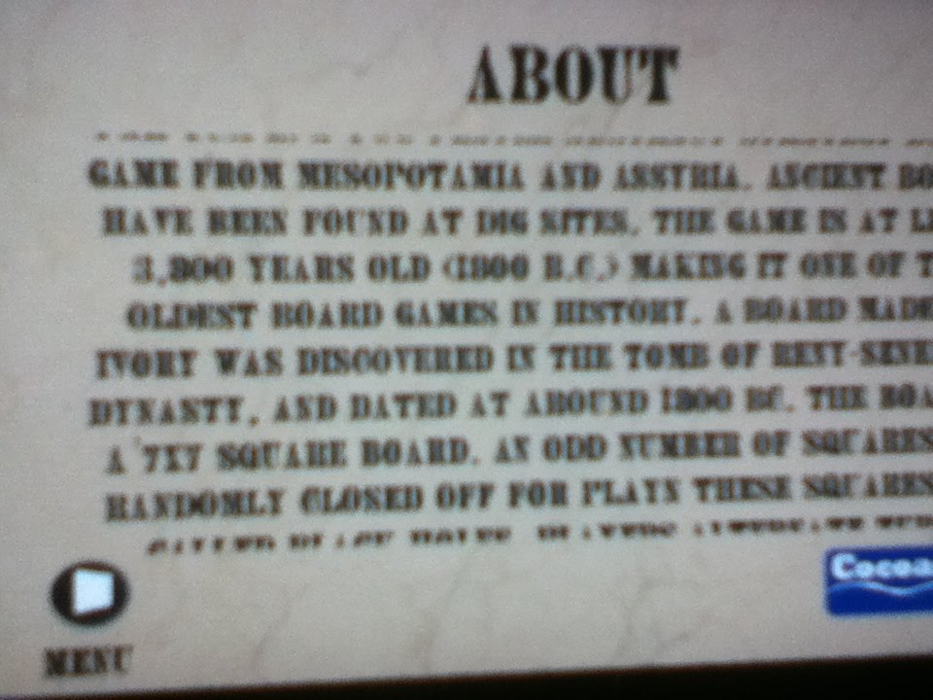
Help and about
Help and Info/About on Desire has first line cut, text is there but is a bit scrolled, still present on all.

Slide 7
Main game and general comments
There is not Resume option, if you go to main menu, you can not get back to same game you just played. Resume option would be important
Turning music on of doesnt work all the time,
Try to set music on and off, try several times, I had problems on Samsung i5800, HTC Desire, HTC Sensation. Please test this heavily, it has issues, if you are in music menu, try to set on off, go to main menu, go back set on or of ...

Slide 8
Torunament testing
how we can simulated the win/loose in the tournament mode? What happens, I did not play all game over to the end ... It needs time, so would be possible to have button for each game play to win or loose?(fixed before 22)
Tournament is not OK, there are quite some bugs, it is not possible to win tournament(fixed before 22)
When you win specific land, there must be orange rectangle around that land is acquired and can not select it again, only if you loose next game you can again select it, please check with J2me game. Once you win/conquere the land, you can not play it until you choose new Tournament play.
This feaures are most critical for tournament play. Please test them very carefully, othervise tournament doesnt have any sense.
Please compare things with J2me game.
When you win game, you can unlock play for next land, if you loose game for next game, you loose the previous land. There are in each of the land specific things, like in Earthqure in Kirkos, Flying UFO that steals the stones when playing with Cirroon etc.
There is also all the time Win check on the screen up to Menu button, what it means? Also if I change language is still same Win... No change.

Slide 9
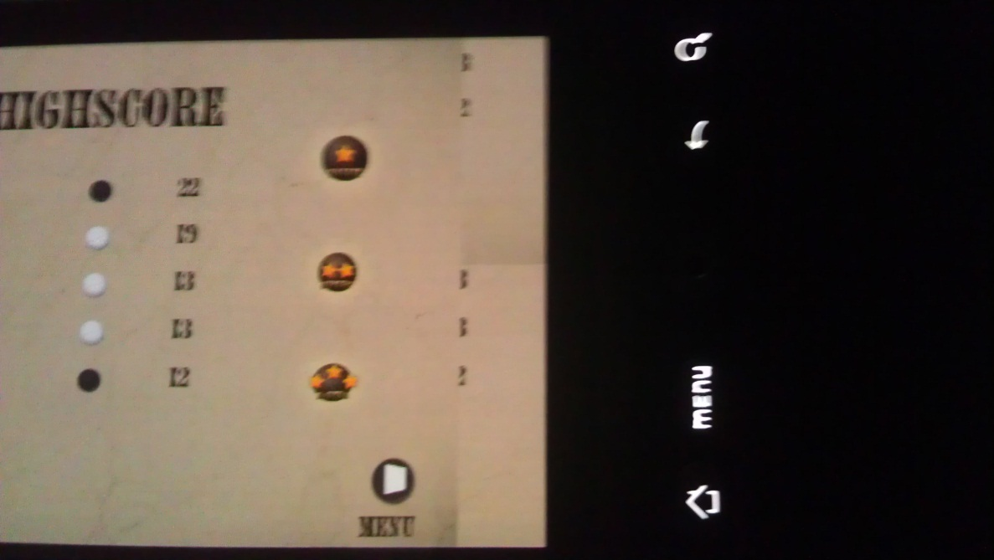
HTC Desire 480x800
Hi scores screen has issues, see here

Slide 10
All phones
Dialog screens (win, loose, exit, etc) should be all same size, now exit screen is smaller, win is bigger than loose, etc.

